Slide 2
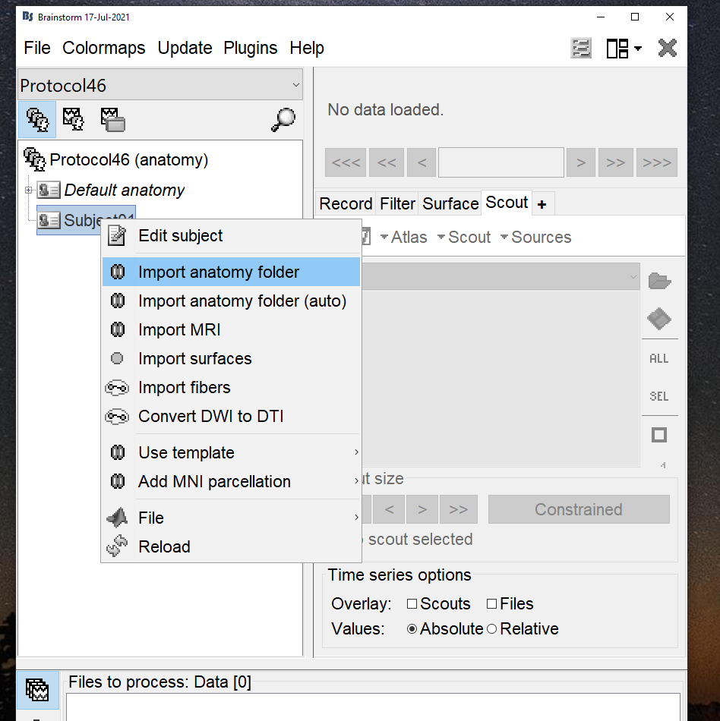
Import anatomy

Slide 3
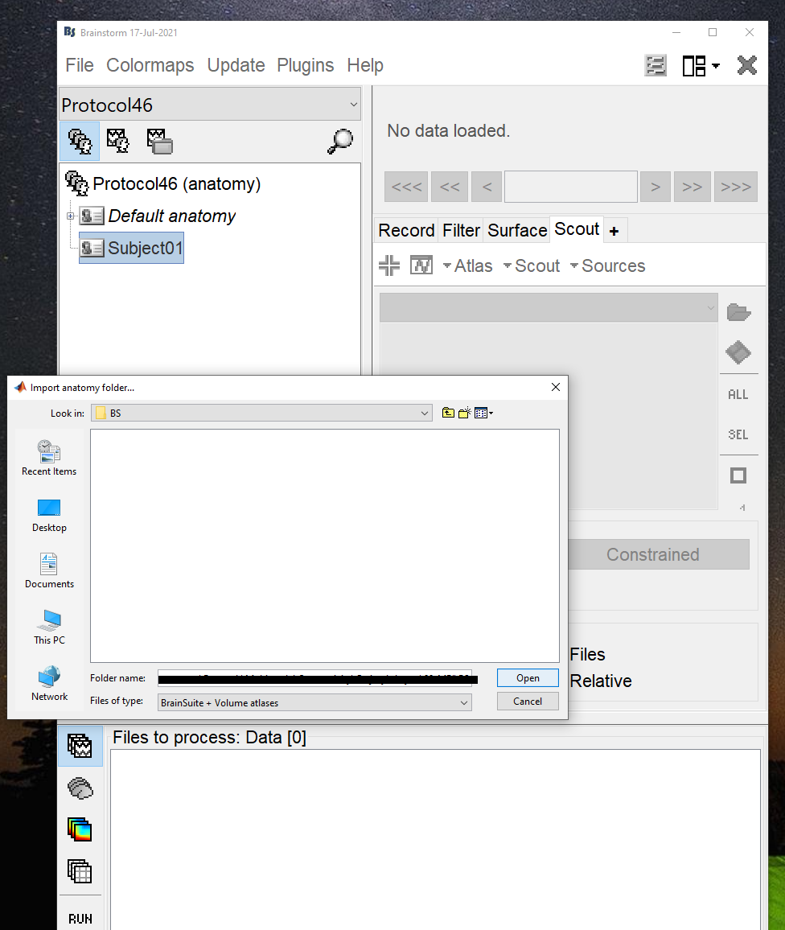
Import brainsuite folder

Slide 4
Atlas imported automatically

Slide 5
Displaying imported atlas and scout

Slide 6
Display the subcortical surface

Slide 7
Subcortical Display. Concern: Shows cortical and subcortical volumes.

Slide 8
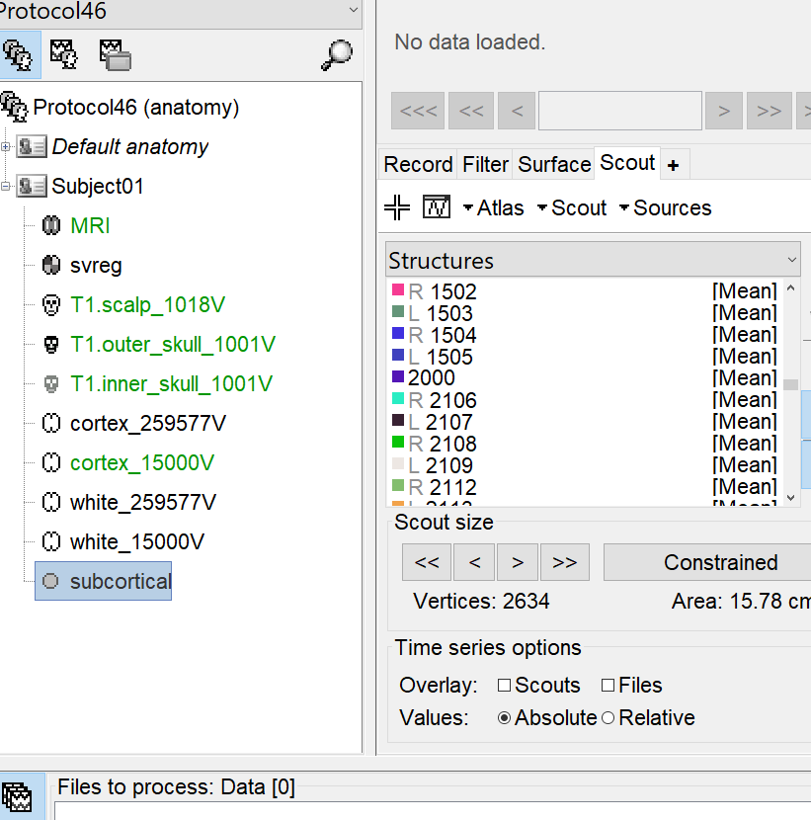
Number of vertices in subcortical regions: 1198874
Number of vertices in cortical surface: 259577
If I am correct, the labels greater than 2000 in brainsuite corresponds to white matter. Which I don’t think should be imported as subcortical structure. Even brainsuite labels between 1000 and 2000 are not subcortical.

