Slide 1
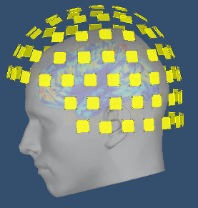






MEG and EEG analysis using
October 2023

Slide 2



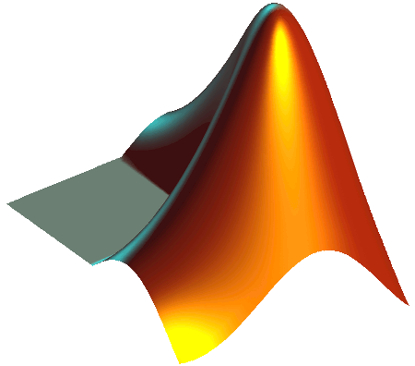

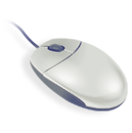
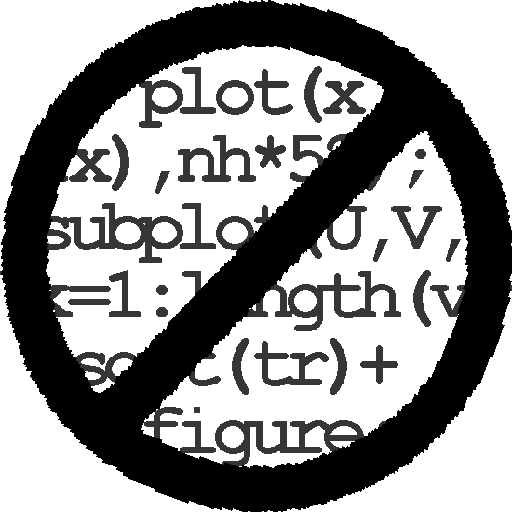
Brainstorm
Free and open-source application
Matlab & Java: Platform-independent
Designed for Matlab
Stand-alone version available
Interface-based: click, drag, drop
No programming experience required
Daily updates of the software
Supports most common file formats

Slide 3
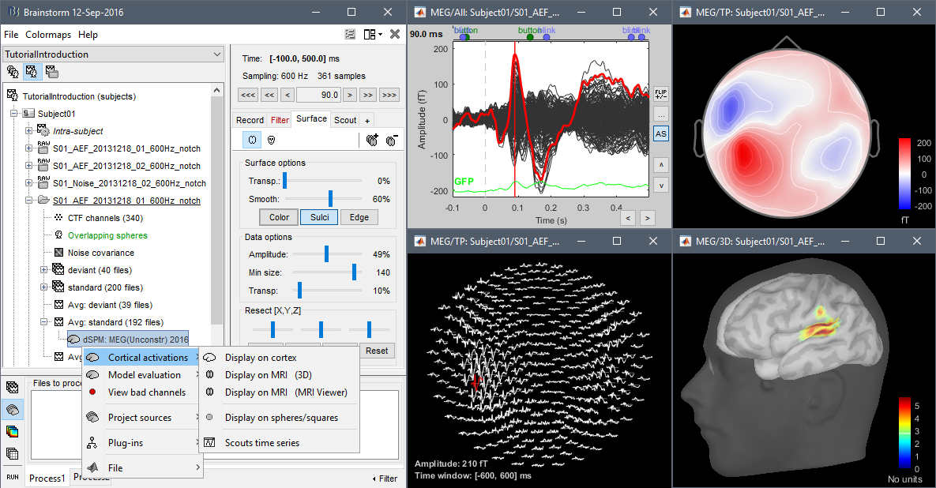
Graphic interface

Slide 4
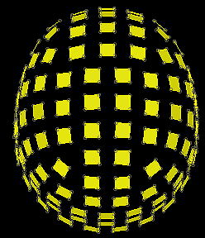
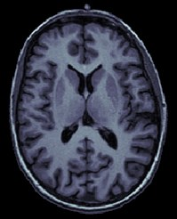
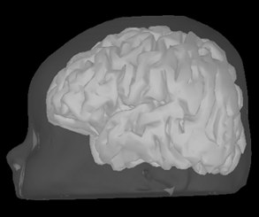
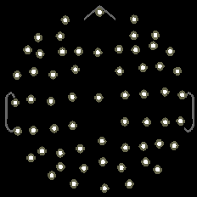
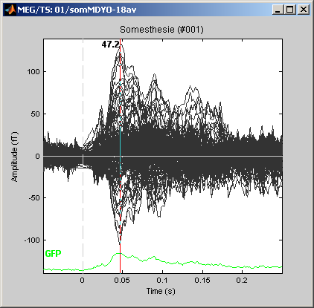
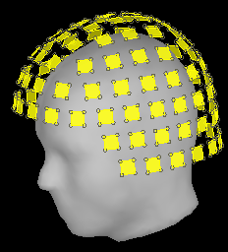
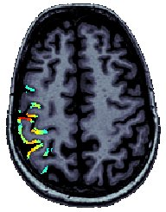
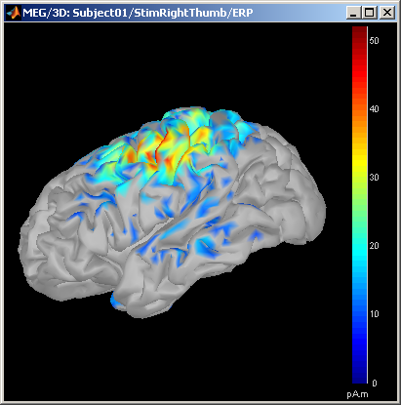
Workflow
Anatomy
Sensors
EEG/MEG
Analysis
Averages
Contrasts
Group analysis
Time-frequency
Connectivity
Co-registration
Source estimation

Slide 5
Single subject
Anatomy
Link recordings
MRI registration
PSD
Filters
Bad channels
Artifacts
Correction
Bad segments
Events
Epoching
Averaging
Sources
Time-frequency
Importing
Loop:
all acquisition runs
all subjects
Pre-processing
Analysis of the
experimental data

Slide 6
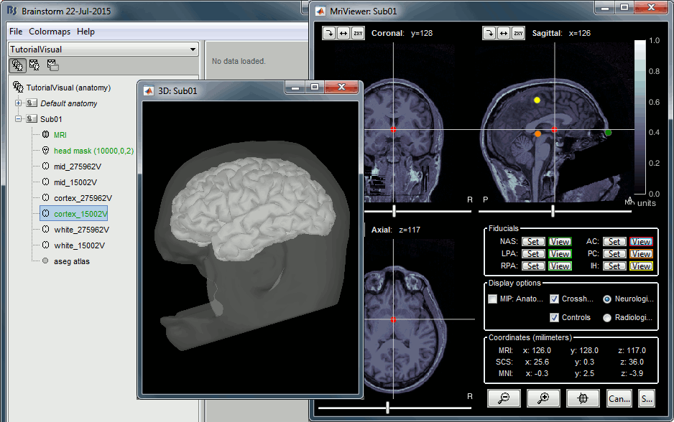
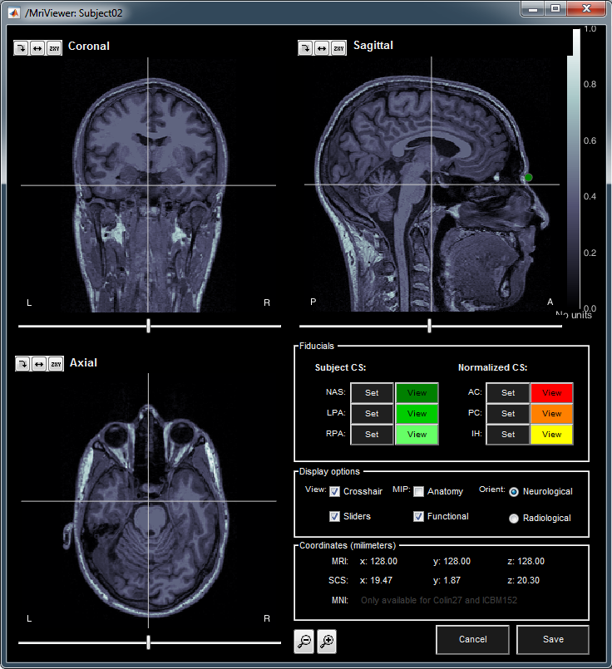
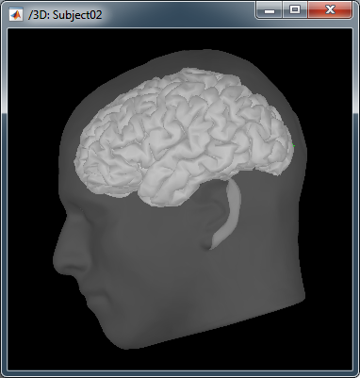
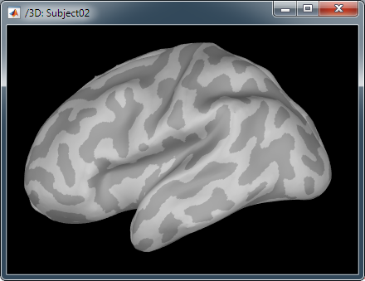
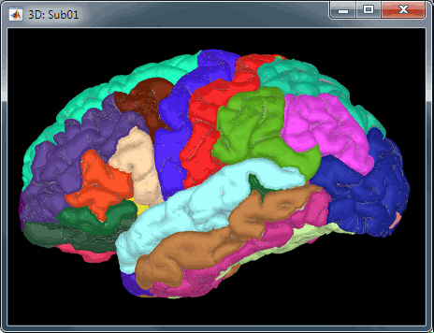
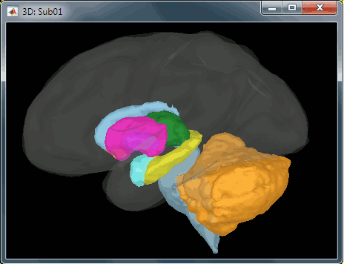
Import
Anatomy
Link recordings
MRI registration
PSD
Filters
Bad channels
Artifacts
Correction
Bad segments
Markers
Epoching
Averaging
Sources
Time-frequency
One-click import of the T1 segmentation:
FreeSurfer, BrainSuite, BrainVISA, CIVET, CAT
Import and place fiducials in the MRI (N,L,R)

Slide 7
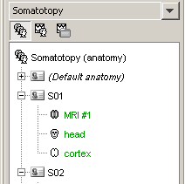
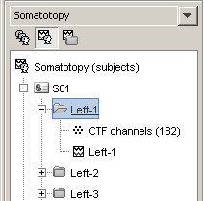
Database
Three levels:
  Protocol
  Subject
  Condition
Popup menus
All files saved in Matlab .mat
Same architecture on the disk

Slide 8
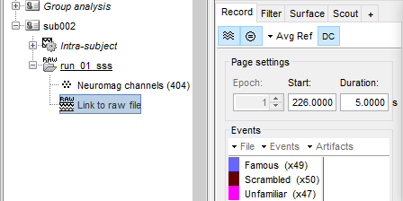
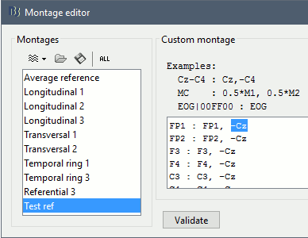
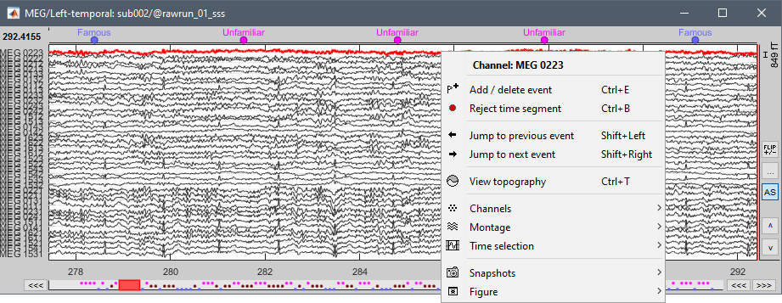
Import
Anatomy
Link recordings
MRI registration
PSD
Filters
Bad channels
Artifacts
Correction
Bad segments
Markers
Epoching
Averaging
Sources
Time-frequency
Original files linked to the database (no copy)
Rich data viewer with flexible montage editor
Optimized reading functions

Slide 9
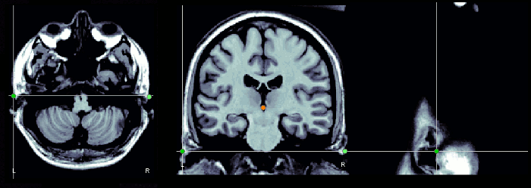
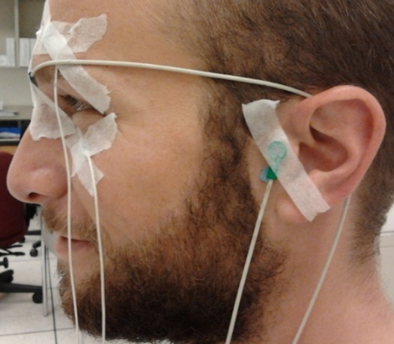
Co-registration MEEG / MRI (1)
Anatomy
Link recordings
MRI registration
PSD
Filters
Bad channels
Artifacts
Correction
Bad segments
Markers
Epoching
Averaging
Sources
Time-frequency
Basic estimation based on three points:
Nasion (NAS), Left ear (LPA), Right ear (RPA)
MRI: Marked in the volume with the MRI Viewer
MEEG: Obtained with a tracking system (Polhemus)

Slide 10
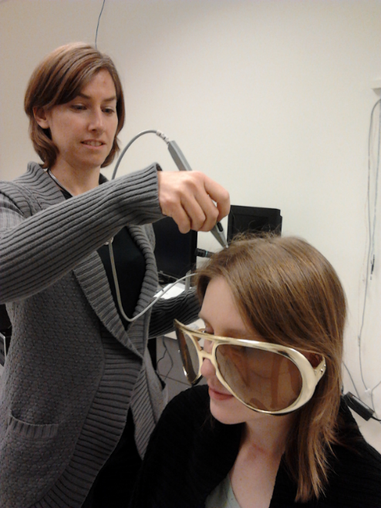
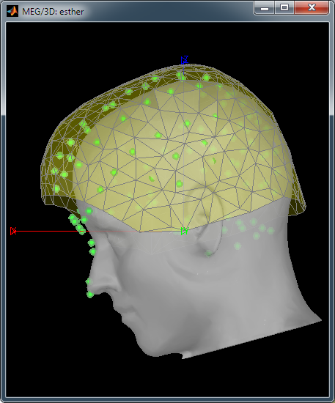
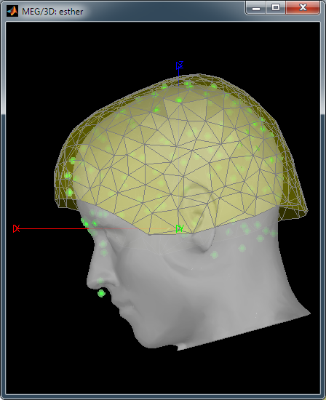
Co-registration MEEG / MRI (2)
Anatomy
Link recordings
MRI registration
PSD
Filters
Bad channels
Artifacts
Correction
Bad segments
Markers
Epoching
Averaging
Sources
Time-frequency
Automatic adjustment based on head shape:
Fitting Polhemus points on the MRI head surface
Final registration must be checked manually
Polhemus driver included in Brainstorm

Slide 11
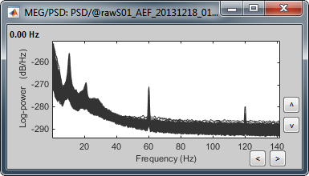
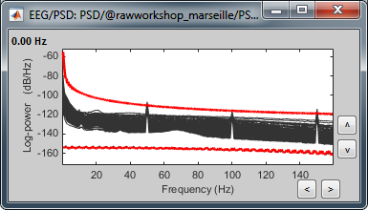
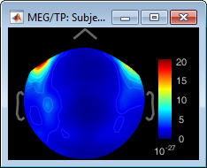
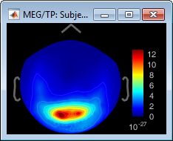
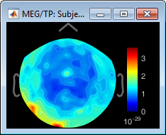
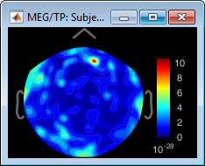
Quality control
Anatomy
Link recordings
MRI registration
PSD
Filters
Bad channels
Artifacts
Correction
Bad segments
Markers
Epoching
Averaging
Sources
Time-frequency
Power spectrum density for quality control
MEG
EEG
Bad channels
< 3Hz: Eyes
10Hz: Alpha
> 40Hz: Muscle
50/60Hz

Slide 12
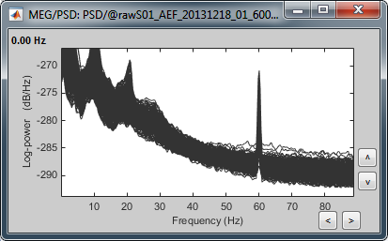
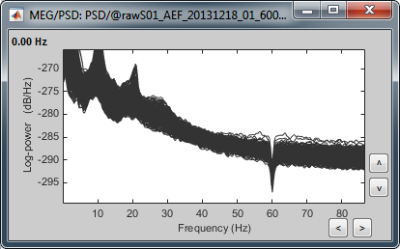
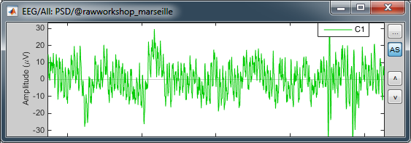
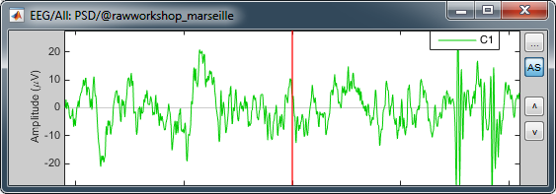
Pre-processing
Anatomy
Link recordings
MRI registration
PSD
Filters
Bad channels
Artifacts
Correction
Bad segments
Markers
Epoching
Averaging
Sources
Time-frequency
Notch filter: Removes 50Hz/60Hz power line noise (and harmonics)
PSD
Signal

Slide 13
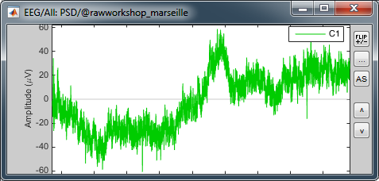
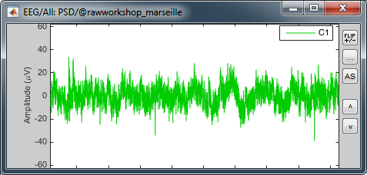
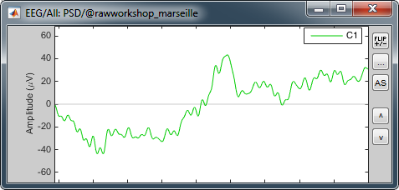
Pre-processing
Anatomy
Link recordings
MRI registration
PSD
Filters
Bad channels
Artifacts
Correction
Bad segments
Markers
Epoching
Averaging
Sources
Time-frequency
High-pass filter: Removes slow components (eye movements, breathing, sensor drifts…)
Low-pass filter: Remove high-frequencies

Slide 14
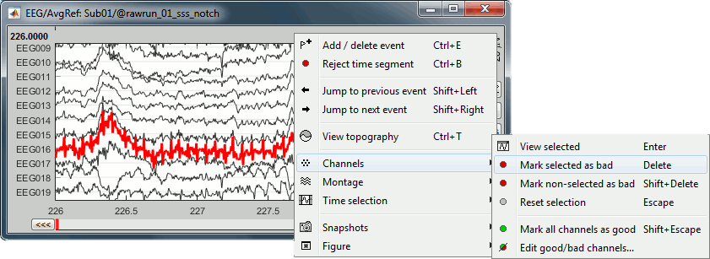
Pre-processing
Anatomy
Link recordings
MRI registration
PSD
Filters
Bad channels
Artifacts
Correction
Bad segments
Markers
Epoching
Averaging
Sources
Time-frequency
Manual inspection of the recordings
Interactive selection of bad channels
Re-reference the EEG if necessary (Average ref)

Slide 15
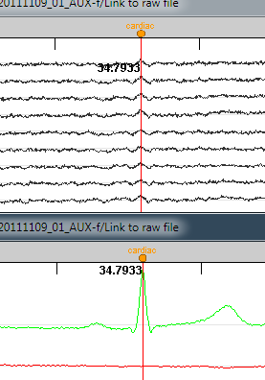
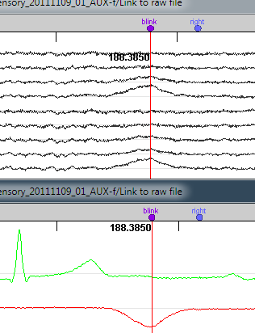
Pre-processing
Anatomy
Link recordings
MRI registration
PSD
Filters
Bad channels
Artifacts
Correction
Bad segments
Markers
Epoching
Averaging
Sources
Time-frequency
Automatic detection of blinks and heartbeats
(peak detection, or explicit amplitude threshold)
ECG
ECG
EOG
EOG

Slide 16
Artifact correction
Two categories of artifacts:
  Well defined, reproducible, short, frequent:
    Heartbeats, eye blinks, eye movements, some stimulators
    Unavoidable and frequent: we cannot just ignore them
    Can be modeled and removed from the signal efficiently
  All the other events that can alter the recordings:
    Movements, building vibrations, metro nearby…
    Too complex or not repeated enough to be modeled
    Safer to mark them as bad segments, and ignore them

Slide 17
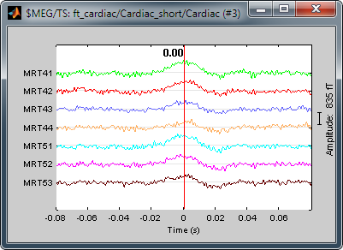
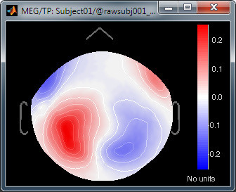
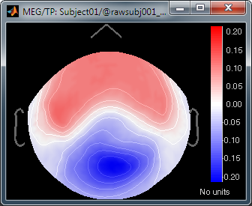
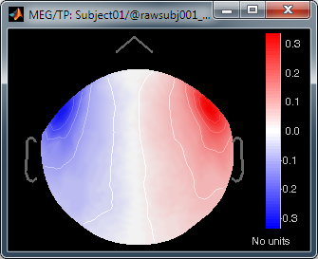
Pre-processing
Anatomy
Link recordings
MRI registration
PSD
Filters
Bad channels
Artifacts
Correction
Bad segments
Markers
Epoching
Averaging
Sources
Time-frequency
Correction with Signal Space Projections (SSP)
Detect artifacts
Spatial components
PCA
Select components and compute a linear projector
to remove their contribution from the recordings

Slide 18
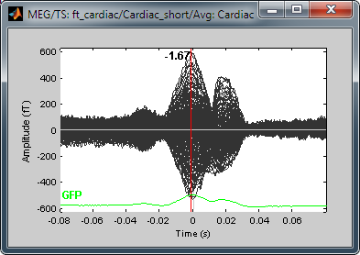




Pre-processing
Anatomy
Link recordings
MRI registration
PSD
Filters
Bad channels
Artifacts
Correction
Bad segments
Markers
Epoching
Averaging
Sources
Time-frequency
Example: Cardiac artifact
Original
SSP

Slide 19

Pre-processing
Anatomy
Link recordings
MRI registration
PSD
Filters
Bad channels
Artifacts
Correction
Bad segments
Markers
Epoching
Averaging
Sources
Time-frequency
Example: Blink

Slide 20

Pre-processing
Independent component analysis (ICA):
  Popular in the EEG literature
  Alternative to SSP for low number of sensors
  Already implemented: Infomax and JADE (EEGLAB)

Slide 21



Pre-processing
Anatomy
Link recordings
MRI registration
PSD
Filters
Bad channels
Artifacts
Correction
Bad segments
Markers
Epoching
Averaging
Sources
Time-frequency
Automatic detection of artifacts (RMS-based)
Manual screening of all the recordings is advised
(scroll all the sensors by pages of 10-20s)
Exclude: Blinks, movements, SQUID jumps

Slide 22


Elekta-Neuromag SQUID jumps
Sharps steps followed by a change of baseline value
Mark the channels as bad before running MaxFilter
Or mark the segments as bad in Brainstorm

Slide 23

Epoching
Anatomy
Link recordings
MRI registration
PSD
Filters
Bad channels
Artifacts
Correction
Bad segments
Markers
Presentation
Sensor
Manual
Two types of experiments:
  Steady-state or resting-state (ongoing activity)
  Event-based (stimulus, response, spike…)
How to get event markers in the recordings?

Slide 24











Epoching
Anatomy
Link recordings
MRI registration
PSD
Filters
Bad channels
Artifacts
Correction
Bad segments
Markers
Presentation
Sensor
Manual
Reading the triggers saved by the presentation software (includes jittered OS delays)
File triggers are never aligned with the real stim
Image production (jittered delays)
Transmission
(fixed or jittered)
Stimulation software
Operating system
Video or
sound card
Projector
Triggers
.fif
MEG signals
Recording (fixed delays)

Slide 25


Epoching
Anatomy
Link recordings
MRI registration
PSD
Filters
Bad channels
Artifacts
Correction
Bad segments
Markers
Presentation
Sensor
Manual
Reading information recorded on the subject side (photodiode, microphone, response box…)
Avoids most uncontrollable jittered delays
Image production (jittered delays)
Transmission
(fixed or jittered)
Stimulation software
Operating system
Video or
sound card
Projector
Triggers
.fif
MEG signals
Photodiode signal
Recording (fixed delays)

Slide 26

Epoching
Anatomy
Link recordings
MRI registration
PSD
Filters
Bad channels
Artifacts
Correction
Bad segments
Markers
Presentation
Sensor
Manual
Reading the triggers save by the presentation software (includes jittered OS delays)
Reading information recorded on the subject side (photodiode, microphone, response box)
Manual or automatic marking of biological or behavioral events, post-acquisition (epileptic spikes, sleep spindles, rat position in a box…)
Optimized workflow for clinicians
(keyboard and mouse shortcuts, workspace…)

Slide 27
Epoching
Anatomy
Link recordings
MRI registration
PSD
Filters
Bad channels
Artifacts
Correction
Bad segments
Markers
Epoching
Combine
Extract
Length
Process
In some experiments, the event of interest is a combination of presentation markers.
Example: Priming experiments
In Brainstorm, the events of interest are saved as new marker types in the continuous files.
In other environments, the events are sometimes defined only at the epoching time and not saved in the continuous file.
A C B C B C A C Markers
E1 E2 E2 E1 Events

Slide 28


Epoching
Anatomy
Link recordings
MRI registration
PSD
Filters
Bad channels
Artifacts
Correction
Bad segments
Markers
Epoching
Combine
Extract
Length
Process
In Brainstorm, the events of interest are saved as new marker types in the continuous files.
In other environments, the events are sometimes defined only at the epoching time and not saved in the continuous file.

Slide 29


Epoching
Anatomy
Link recordings
MRI registration
PSD
Filters
Bad channels
Artifacts
Correction
Bad segments
Markers
Epoching
Combine
Extract
Length
Process
Epochs = Trials = Short blocks of recordings around an event of interest.
Epoching = Extracting epochs from the continuous recordings and saving them.

Slide 30



Epoching
Anatomy
Link recordings
MRI registration
PSD
Filters
Bad channels
Artifacts
Correction
Bad segments
Markers
Epoching
Combine
Extract
Length
Process
In Brainstorm, each imported epoch is an independent file in the database.
Accessible by event type or individually.
In other programs, all the epochs from one run are saved in one single file (one file per event type, or one file with all the events).

Slide 31


Epoching
Anatomy
Link recordings
MRI registration
PSD
Filters
Bad channels
Artifacts
Correction
Bad segments
Markers
Epoching
Combine
Extract
Length
Process
How to define the optimal epoch length ?
Experimental design:
Expected effect duration, inter-stimulus interval
Analysis: Frequency filters and amplitude normalizations may require longer epochs
Computational limitations: Size and time
[0,900] ms
+ 200ms baseline
+ 300ms filters
= [-500, 1200] ms

Slide 32


Epoching
Anatomy
Link recordings
MRI registration
PSD
Filters
Bad channels
Artifacts
Correction
Bad segments
Markers
Epoching
Combine
Extract
Length
Process
Processing steps that can be applied on epochs:
  DC offset correction: Subtract the average estimated over a baseline period
  Detrending: Subtract a linear trend estimated over a reference period
  Resampling: Decrease the sampling rate
This dataset: DC correction, baseline=[-500,0]ms

Slide 33







Single subject
Anatomy
Link recordings
MRI registration
PSD
Filters
Bad channels
Artifacts
Correction
Bad segments
Markers
Epoching
Averaging
Sources
Time-frequency
Averaging the trials: Reveals the features of the signals that are locked in time to a given event
= Event-related field / potential
= Evoked response
= ERF/ERP
MEG
EEG

Slide 34
Single subject
Anatomy
Link recordings
MRI registration
PSD
Filters
Bad channels
Artifacts
Correction
Bad segments
Markers
Epoching
Averaging
Sources
Time-frequency
EEG: Averaging data across runs and subjects OK.
MEG: Averaging across runs is not always accurate
  Head shapes differ between subjects.
  Head positions different between runs.
  One sensor does not record the same thing in two different runs.
  Coregistration of runs with Elekta MaxFilter helps but modifies a lot the recordings.
  Never use this to average across subjects.
  Recommended: Estimate the sources for each run separately, then average in source space.

Slide 35




Single subject
Anatomy
Link recordings
MRI registration
PSD
Filters
Bad channels
Artifacts
Correction
Bad segments
Markers
Epoching
Averaging
Sources
Time-frequency
EEG ERP: Famous faces

Slide 36








Single subject
Anatomy
Link recordings
MRI registration
PSD
Filters
Bad channels
Artifacts
Correction
Bad segments
Markers
Epoching
Averaging
Sources
Time-frequency
Sensor space: EEG or MEG sensors
Source space: Cortex or full head volume
Forward model: Overlapping spheres (MEG)
OpenMEEG BEM/DUNEuro FEM (EEG)
Inverse model: Minimum norm estimates
Beamformers
Separately for MEG and EEG
Forward
Inverse
Sensor space
Source space

Slide 37




Single subject
Anatomy
Link recordings
MRI registration
PSD
Filters
Bad channels
Artifacts
Correction
Bad segments
Markers
Epoching
Averaging
Sources
Time-frequency
The MNE model requires an estimation of the level of noise of the sensors
Noise covariance matrix = covariance of segments that do not contain any “meaningful” data
Empty room, pre-stim baseline, resting
T

Slide 38

Single subject
Anatomy
Link recordings
MRI registration
PSD
Filters
Bad channels
Artifacts
Correction
Bad segments
Markers
Epoching
Averaging
Sources
Time-frequency
Famous faces
MEG
EEG
MEG sources

Slide 39



Single subject
Anatomy
Link recordings
MRI registration
PSD
Filters
Bad channels
Artifacts
Correction
Bad segments
Markers
Epoching
Averaging
Sources
Time-frequency
Regions of interest at cortical level (scouts)
= Subset of a few dipoles in the brain
= Group of vertices of the cortex surface

Slide 40


Single subject
Anatomy
Link recordings
MRI registration
PSD
Filters
Bad channels
Artifacts
Correction
Bad segments
Markers
Epoching
Averaging
Sources
Time-frequency
Dipole scanning
Compute a distributed source model, then find the most significant dipole at each time sample.
Dipole fitting (FieldTrip)
Non-linear search of the dipoles that minimizes the residuals (data explained - recordings)

Slide 41



Single subject
Anatomy
Link recordings
MRI registration
PSD
Filters
Bad channels
Artifacts
Correction
Bad segments
Markers
Epoching
Averaging
Sources
Time-frequency
Faces – Scrambled, 160ms

Slide 42

Source estimation: MEG
Recommended in MEG analysis:
  The subject head can move in the helmet
  One sensor is not corresponding to one brain region
  Different types of sensors (magneto / gradiometers)
  Difficult to read, reproduce or compare
Converting to source space helps solving those issues
M.Hamalainen 2007

Slide 43








MEG sensors
CTF (MNI)
Elekta (MIT)
275 axial gradiometers
204 planar gradiometers
102 magnetometers

Slide 44
Source estimation: EEG
In EEG, those problems don’t exist:
  Electrodes positions are fixed and known
  More reproducible signal shapes and topographies
  Clinicians are trained to work at the sensor level
But the source reconstruction is still interesting:
  Localize the signal generators in the brain
  (epilepsy and pre-surgical functional mapping)
  Spatial separation of simultaneous sources

Slide 45








Single subject
Anatomy
Link recordings
MRI registration
PSD
Filters
Bad channels
Artifacts
Correction
Bad segments
Markers
Epoching
Averaging
Sources
Time-frequency
Morlet wavelets
Hilbert transform + band-pass filter

Slide 46


Single subject Sub002 / R01
Anatomy
Link recordings
MRI registration
PSD
Filters
Bad channels
Artifacts
Correction
Bad segments
Markers
Epoching
Averaging
Sources
Time-frequency
Make sure you know the transient periods for all the frequency bins, and do not include them in your analysis.
An easy solution is to cut them out immediately after the computation.

Slide 47
Time-frequency Average

Slide 48

Time-frequency

Slide 49

Single subject
Anatomy
Link recordings
MRI registration
PSD
Filters
Bad channels
Artifacts
Correction
Bad segments
Markers
Epoching
Averaging
Sources
Time-frequency
Other measures
Phase-amplitude coupling

Slide 50



Single subject
Anatomy
Link recordings
MRI registration
PSD
Filters
Bad channels
Artifacts
Correction
Bad segments
Markers
Epoching
Averaging
Sources
Time-frequency
Other measures
Connectivity measures
Correlation
Coherence
Phase locking value
Granger causality

Slide 51


Group analysis
Anatomy
Link recordings
MRI registration
PSD
Filters
Bad channels
Artifacts
Correction
Bad segments
Markers
Epoching
Averaging
Sources
Time-frequency
Group averages
Project to template
(sources only)
Statistical tests
Normalize
(TF and sources)
Low-pass filter
Subject averages
Weighted avg
Run averages
N subjects x M runs
N averages

Slide 52
Group analysis
Subject averages
Low-pass
Normalize
Project
Group averages
Group statistics
Quality control
Workflow
Weighted average of 6 runs per subject
(recordings, sources MEG/EEG, time-frequency)
Sources: Compute within-subject differences
  (Faces - Scrambled) and (Famous - Unfamiliar)
  The sign of the MNE source amplitude is ambiguous, we will apply an absolute value before comparing between subjects

Slide 53






Group analysis
Subject averages
Low-pass
Normalize
Project
Group averages
Group statistics
Quality control
Workflow
Low-pass filter the subject averages: 32Hz
Remove 300ms on each side (edge effects)

Slide 54




Group analysis
Subject averages
Low-pass
Normalize
Project
Group averages
Group statistics
Quality control
Workflow
  Amplitude normalization before group analysis
  Baseline = [-200,0]ms
Sources: Z-score normalization wrt baseline
S = (S – mean(baseline)) / std(baseline)
Time-frequency: Event-related sync/desync
TF = (TF – mean(baseline)) / mean(baseline) * 100

Slide 55




Group analysis
Subject averages
Low-pass
Normalize
Project
Group averages
Group statistics
Quality control
Workflow
Using FreeSurfer registration
FreeSurfer
registration
Subject
3D interpolation
Template
FreeSurfer
registration

Slide 56


Group analysis
Subject averages
Low-pass
Normalize
Project
Group averages
Group statistics
Quality control
Workflow
Using BrainSuite registration
BrainSuite
registration
Subject
3D interpolation
Template
BrainSuite
registration

Slide 57




Group analysis
Subject averages
Low-pass
Normalize
Project
Group averages
Group statistics
Quality control
Workflow
Registration of individual sources on a template
(ICBM152, Colin27, DNI, infants…)
Subject 1
Group analysis
Average
Contrast
…
Subject 2
Individual anatomy
Standard anatomy

Slide 58






Group analysis
Subject averages
Low-pass
Normalize
Project
Group averages
Group statistics
Quality control
Workflow
Faces - Scrambled
EEG 070
MEG
EEG
ROI MEG
MEG Z>3
EEG Z>3
ROI EEG

Slide 59




Group analysis
Subject averages
Low-pass
Normalize
Project
Group averages
Group statistics
Quality control
Workflow
Parametric Chi2-test
log(|Faces-Scrambled|)=0
p<0.05 FDR-corrected
Faces - Scrambled
Permutation t-test, 1000 rand, p<0.05 FDR-corrected
MEG
MEG
EEG
FieldTrip cluster test, cluster alpha=0.05, 1000 rand
EEG
EEG

Slide 60


Group analysis
Subject averages
Low-pass
Normalize
Project
Group averages
Group statistics
Quality control
Workflow
Contrasts between subjects or conditions
Parametric t-test
Cluster-based non-parametric tests
Export to: SPM, R, Excel, SPSS, Matlab…

Slide 61



Group analysis
Subject averages
Low-pass
Normalize
Project
Group averages
Group statistics
Quality control
Workflow
When scripting the analysis, we recommend you always check visually the following items for each run separately:
  MRI/sensors registration
  PSD before and after filters
  SSP and ICA component topographies
  ERP/ERF: Sensors time series
  ERP/ERF: Sensors topo of primary response
  ERP/ERF: Sources of primary response
  Any other metric of interest

Slide 62



Group analysis
Subject averages
Low-pass
Normalize
Project
Group averages
Group statistics
Quality control
Workflow
Execution reports with snapshots saved in HTML

Slide 63
Group analysis
Subject averages
Low-pass
Normalize
Project
Group averages
Group statistics
Quality control
Workflow
Prototype the analysis interactively with one subject.
Write down all the parameters to reproduce with a script.
Set the anatomical fiducials for all the subjects.
Script #1: Import the anatomy for all the subjects
Script #2: Pre-processing (loop on subjects)
  Link the raw files, register with MRI, compute PSD
  Detect or import event markers
  Pre-processing: Filtering, detect artifacts, SSP, ICA
Manual inspection:
  Check the execution reports for script 2
  Fix the SSP/ICA (re-compute, manual selection)
  Mark bad channels and bad segments

Slide 64
Group analysis
Subject averages
Low-pass
Normalize
Project
Group averages
Group statistics
Quality control
Workflow
Script #3: Subject-level analysis (loop on subjects)
  Importing and averaging
  Source estimation
  Time-frequency
Manual inspection:
  Check the execution reports for script #3
  Define regions of interest
Script #4: Group analysis
  Subject-level averages
  Group-level averages
  Statistics
  Anything that involves regions of interest

Slide 65
Add your code to Brainstorm
Direct manipulation of the files in Matlab
Use the menu “Run Matlab command”
Write a plugin:
  Well documented API
  Lots of example (170 functions written as plugins)
  Open-source GitHub repository
Examples of recent external contributions:
  MVPA decoding (Oliva, MIT)
  Microstate segmentation (Cacioppo, UChicago)
  Eyetracker/EEG synchronization (Uni Freiburg)

Slide 66


User community (2023)
40,000+ users registered on the website

Slide 67




User support
Online tutorials: 30-hour self-training program
Active user forum: 150 posts/month
Daily updates: 1500 downloads/month
@BrainstormSoftware
@brainstorm2day
@brainstorm-tools

Slide 68



















Contributors
Sylvain Baillet
MNI
Konstantinos Nasiotis
Post-doc
Elizabeth Bock
MEGIN, Chicago
Richard Leahy
USC
Guiomar Niso
Politécnica Madrid
McGill
Soheila Samiee
PhD student
Collaborators
Investigators
John Mosher
Cleveland Clinic
Juan García-Prieto
Martinos Ctr, MGH
Jeremy Moreau
PhD student
Dimitrios Pantazis
MIT
Christophe Grova
Concordia
Anand Joshi
RA Professor
François Tadel
Software, Grenoble
NIRSTORM
Thomas Vincent
Montreal Heart Inst.
USC
Hossein Shahabi
Research assistant
Engineers
Raymundo Cassani
Software, MNI
Edouard Delaire
Concordia
Marc Lalancette
MEG manager, MNI
Takfarinas Medani
Research assistant

Slide 69



Next Brainstorm Workshop
2nd International Conference on
Artificial Intelligence in Epilepsy
and Neurological Disorders
April 1st – 4th 2024
Park city, ut, usa
www.AIEPILEPSY-NEURO.com
Algorithms, machine learning, deep learning and artificial intelligence in epilepsy and neurological disorder clinical care, practice and research with special emphasis on devices, wearables, apps and platforms
This year on April 1st we will also hold a special Workshop on the Brainstorm Platform for Clinicians and Scientists and its use in Stereotactic EEG and Epilepsy Surgery
Organizing Committee:
Sam Lhatoo MD, Philippe Ryvlin, Michael Sperling, Sandor Beniczky
For any information: Aiepilepsy-neuro@ant-congres.com

Slide 70






Team today
Raymundo Cassani
Takfarinas Medani
Woojae Jeong
Chinmay Chinara
John
Mosher
Richard Leahy

Slide 71
Workshop dataset
  Visual recognition task
Faces presentation: Famous / Unfamiliar / Scrambled
1 participant / 1 run / aprox. 50 trials per condition
400-600ms fixation cross, 800-1000 stim, 1700ms ISI
Total 10min per run
Elekta-Neuromag VectorView system (MEG+EEG)
102 magnetometers, 204 gradiometers, 70 electrodes
Recorded at 1100Hz
• Individual MRI, anonymized, processed with FreeSurfer 5.3

Slide 72




Workshop dataset
  Median nerve stimulation
Right arm stimulation: monophasic square-wave
duration 0.3 ms at 2.8 Hz
1 participant / 1 run / 336 stimuli
Individual MRI, processed with CAT12
MEG: Yokogawa 160 axial gradiometers @ 2000 Hz
EEG: Nihon Kohden 41 electrodes @ 2000 Hz
Median nerve percutaneous stimulation
Scalp and cortical surface
EEG electrodes and MEG helmet
Simultaneous MEG and EEG acquisition

Slide 73



Acquisition setup
Stim
MEG and EMG
Stimulation
computer
Acquisition
computer

